Slide 1
Chronic Kidney Disease Identification in HIV Infected Patients using Machine Learning
Project Presentation by
JAICHANDRAN J - (1CR18IS065)
MARUTH KUMAR V – (1CR18IS089)
Under the Guidance of
Mrs.RASHMI D
ASSISTANT PROFESSOR
INFORMATION SCIENCE &ENGINEERING

Slide 2
Agenda:
Problem Statement
Abstract
Introduction
Objectives
Proposed Model
Required Analysis
Design Implementation
Algorithm used
Results & Discussions
Conclusion
Future Scope
References

Slide 3
PROBLEM STATEMENT
To Implement Chronic Kidney Disease Identification in HIV Infected Patients using Machine Learning algorithm

Slide 4
ABSTRACT
The Chronic Kidney Disease (CKD) is one of the deadliest diseases that slowly damages human kidney. The disease remains undetected in its early stage and the patients can only realize the severity of the disease when it gets advanced people infected with hiv often suffer from ckd
In our proposed system we compare and analyze different Machine learning algorithm such as Naïve bayes, KNN, Decision Tree Classifier, SVM, Logical Regression and SGD and to predict ckd for individual human

Slide 5
INTRODUCTION
Two bean-shaped organs, named kidney, are two important parts in human body. Kidney removes waste from blood by filtering. When kidney loses its ability to filter result in failure of kidney is called Chronic Kidney Disease
There are some symptoms which shows kidneys are beginning to fail like muscle cramps, nausea and weight loss, , swelling in your feet and ankles, too much urine or not enough urine, shortness of breath, trouble sleeping, fever and vomiting.
Risk factors of CKD are diabetes, smoking, lack of sleeping, hyper- tension, improper diet, etc. Among them diabetes is the more dangerous factor. At the last stage, the patient must take dialysis or do kidney transplantation. One of the best ways to reduce this death rate is early treatment.

Slide 6
Objective
CKD remains undetected in its early stage and the patients can only realize the severity of the disease when it gets advanced.
Hence, detecting such disease at earlier stage is a key challenge now.
This project helps to raise awareness among people and to promote early diagnosis
Early prediction and proper treatments can possibly stop, or slow the progression of this chronic disease

Slide 7
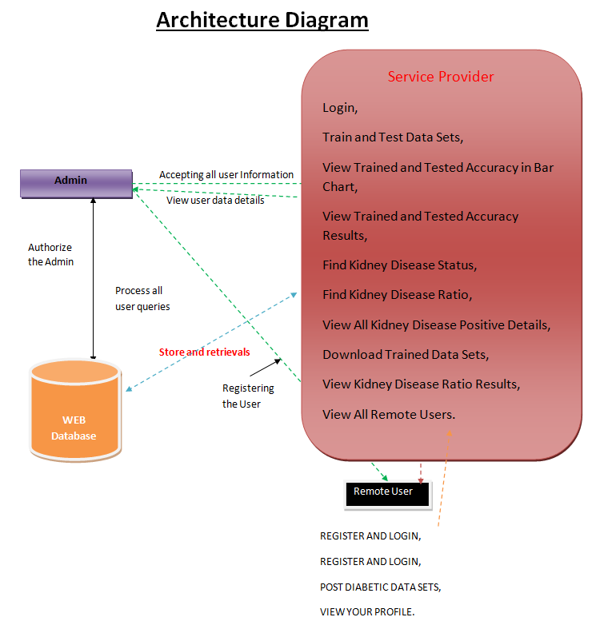
PROPOSED MODEL
Basic system Architecture

Slide 8
PROPOSED MODEL
Remote user:
A User should register before doing any operations. Once user registers, their details will be stored to the database. After registration successful, he has to login by using authorized user name and password. Once Login is successful user will do some operations like POST DIABETIC DATA SETS,VIEW YOUR PROFILE. and user should enter the dataset value for individual person to predict as positive or negative
Service provider :
the Service Provider has to login by using valid user name and password. After login successful he can do some operations such as Train and Test Data Sets,View Trained and Tested Accuracy in Bar Chart,View Trained and Tested Accuracy Results,Find Kidney Disease Status,Find Kidney Disease Ratio,View All Kidney Disease Positive Details, Download Trained Data Sets,View Kidney Disease Ratio Results,View All Remote Users

Slide 9
REQUIREMENT ANALYSIS
Software Requirements:
Operating System : Windows ,7,8,10
Coding Language : Python
Front End : HTML,CSS,Javascript
Backend : Django-ORM
Database : MySQL(xampp server)

Slide 10
REQUIREMENT ANALYSIS
Hardware Requirements:
Processor : Dual Core
Speed : 1.1 GHz
RAM : 4 GB (min)
Hard Disk : 20 GB
Key Board : Standard Windows Keyboard
Mouse : Two or Three Button Mouse
Monitor : SVGA

Slide 11
DESIGN AND IMPLEMENTATION
Dataset selection and Data Preprocessing – Selection of the correct dataset and preprocessing the data to remove any noise
Execution of Algorithms – Implement the algorithms for the given dataset. KNN, Decision Tree, SVM, SGD, Naïve Bayes, Logistic regression is used to compare the results and come up with the best method.
The Classification of control metrics and predicting the most effective algorithm – Compare the performance of the algorithms based on the several control metrics. Plot the graphs depicting actual and predicted values and determine the most effective algorithm.

Slide 12
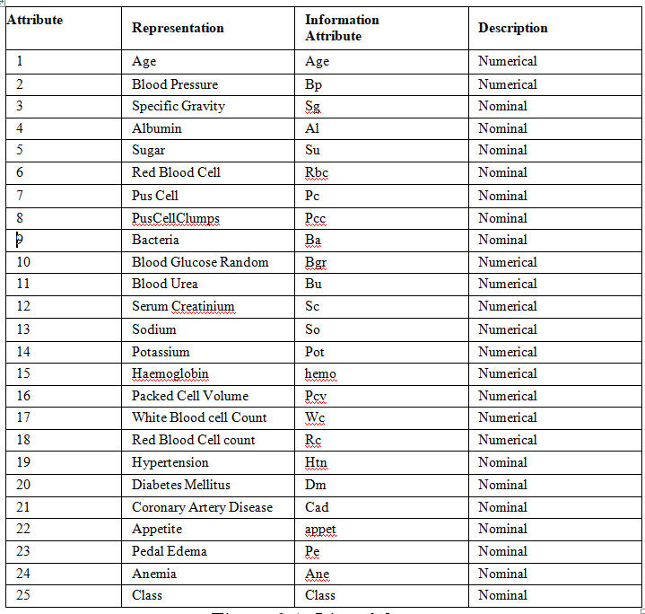
DESIGN AND IMPLEMENTATION
Dataset
For the system, the dataset was collected from a variety of source but the main source was kaggle website . It contains 400 samples of patients having 25 attributes

Slide 13
ALOGRITHM USED
KNN The k-nearest neighbors algorithm, also known as KNN or k-NN, is a non-parametric, supervised learning classifier, which uses proximity to make classifications or predictions about the grouping of an individual data point
Logistic regression is a supervised learning classification algorithm used to predict the probability of a target variable. The nature of target or dependent variable is dichotomous, which means there would be only two possible classes.
Decision Tree is the most powerful and popular tool for classification and prediction. A Decision tree is a flowchart-like tree structure, where each internal node denotes a test on an attribute, each branch represents an outcome of the test, and each leaf node (terminal node) holds a class label
Stochastic Gradient Descent is a probabilistic approximation of Gradient Descent. It is an approximation because, at each step, the algorithm calculates the gradient for one observation picked at random, instead of calculating the gradient for the entire dataset

Slide 14
Algorithm used
Support Vector Machine The objective of applying SVMs is to find the best line in two dimensions or the best hyperplane in more than two dimensions in order to help us separate our space into classes. The hyperplane (line) is found through the maximum margin, i.e., the maximum distance between data points of both classes.
Naive Bayes classification algorithm is a probabilistic classifier. It is based on probability models that incorporate strong independence assumptions. The independence assumptions often do not have an impact on reality. Therefore they are considered as naive.

Slide 15


RESULTS AND DISCUSSION
Remote user: In this page the user can register by entering the details and user can login.

Slide 16
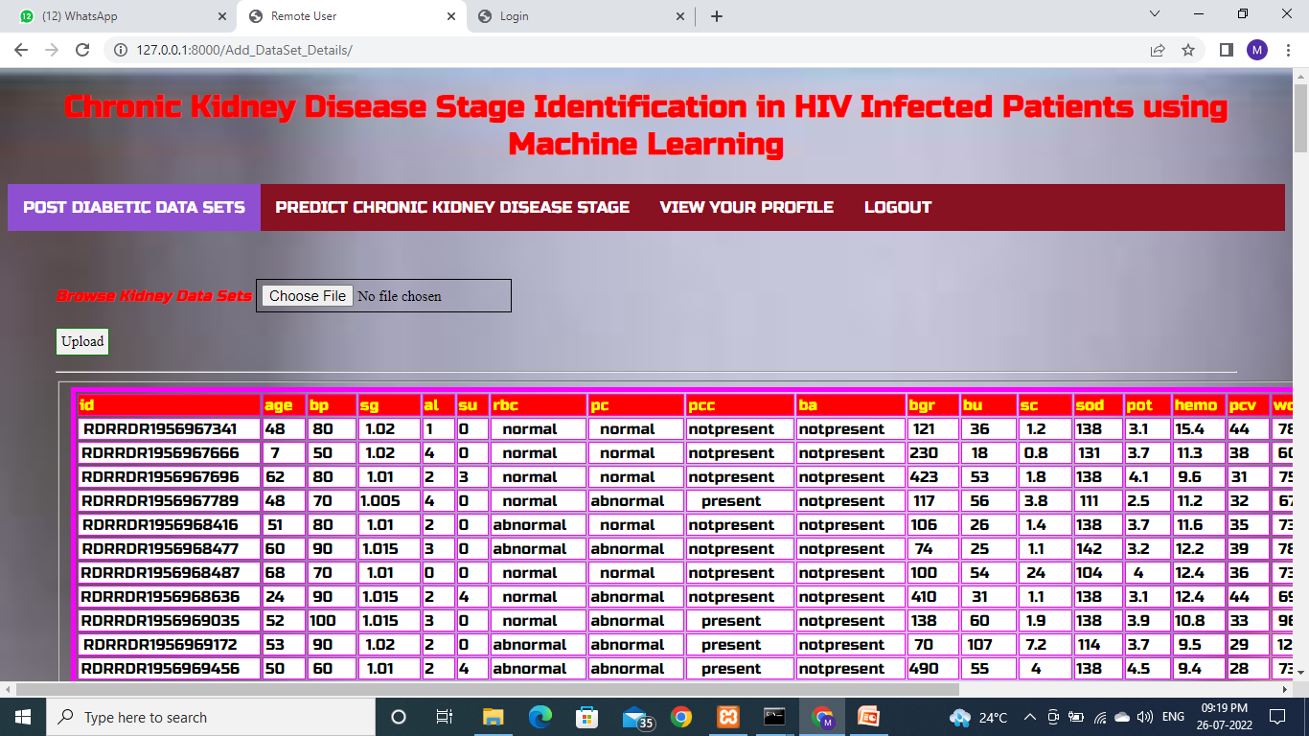
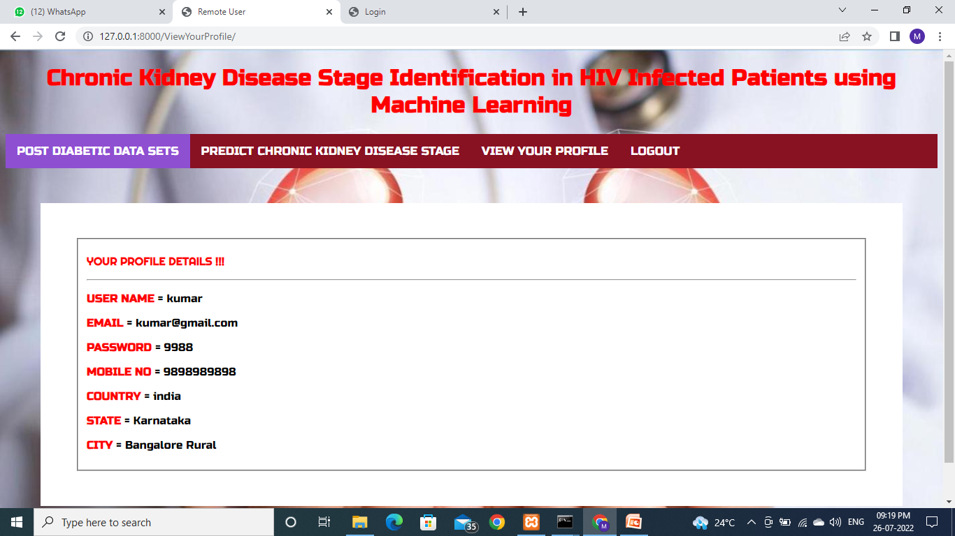
Remote User

Slide 17
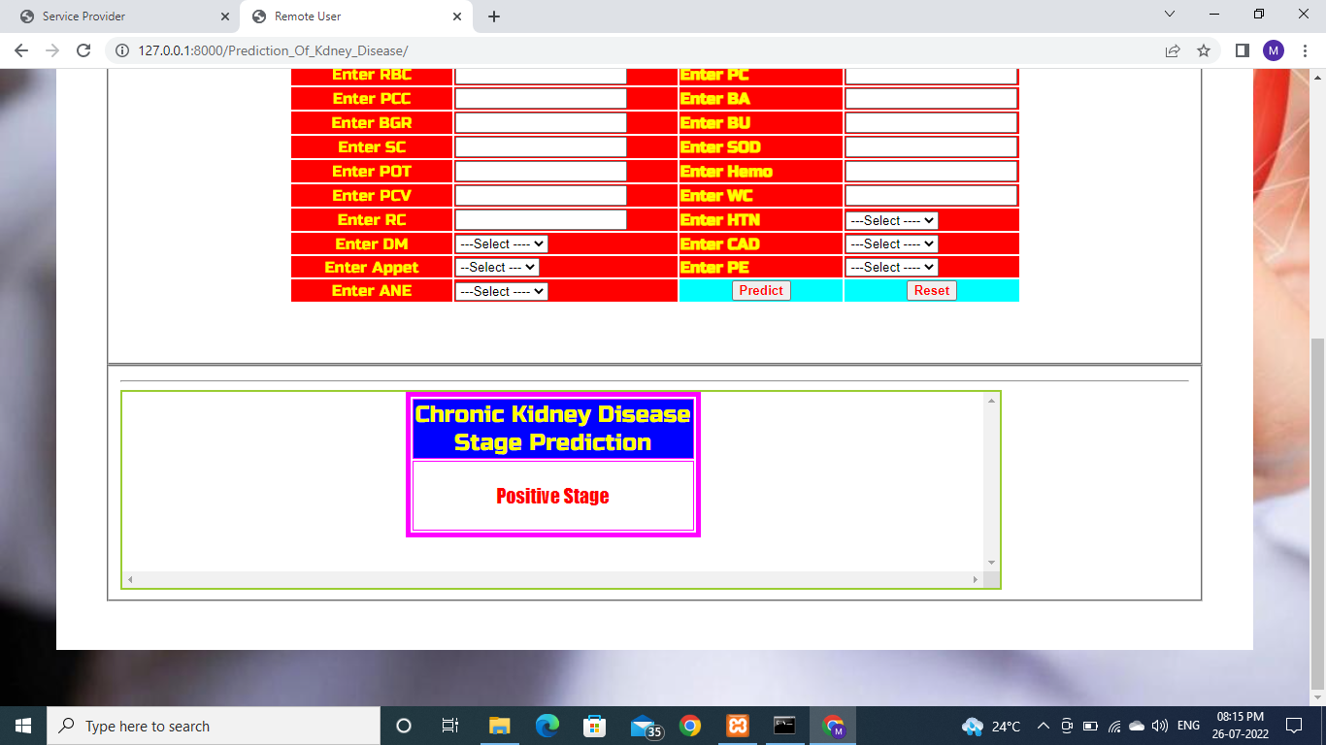
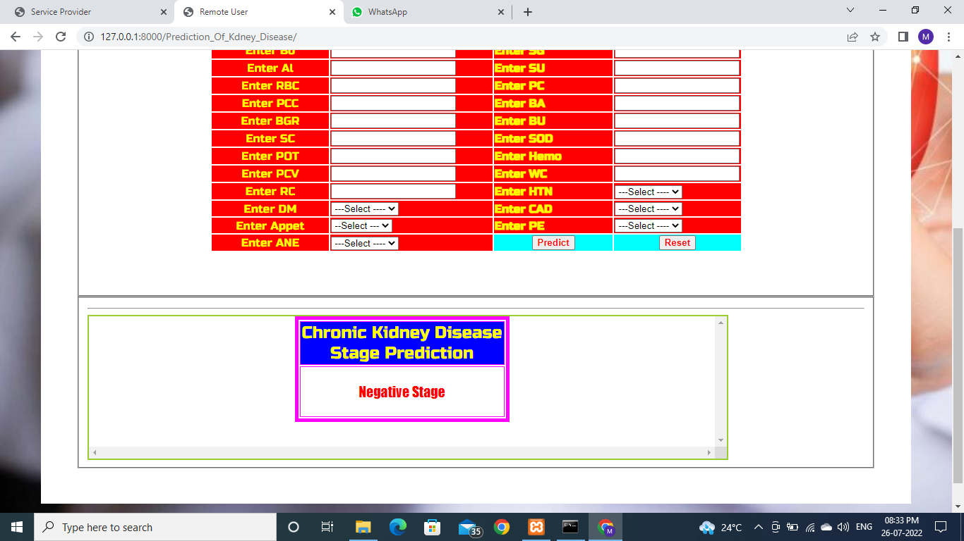
Remote User

Slide 18

Service Provider
Service Provider: In this page the admin can login.

Slide 19

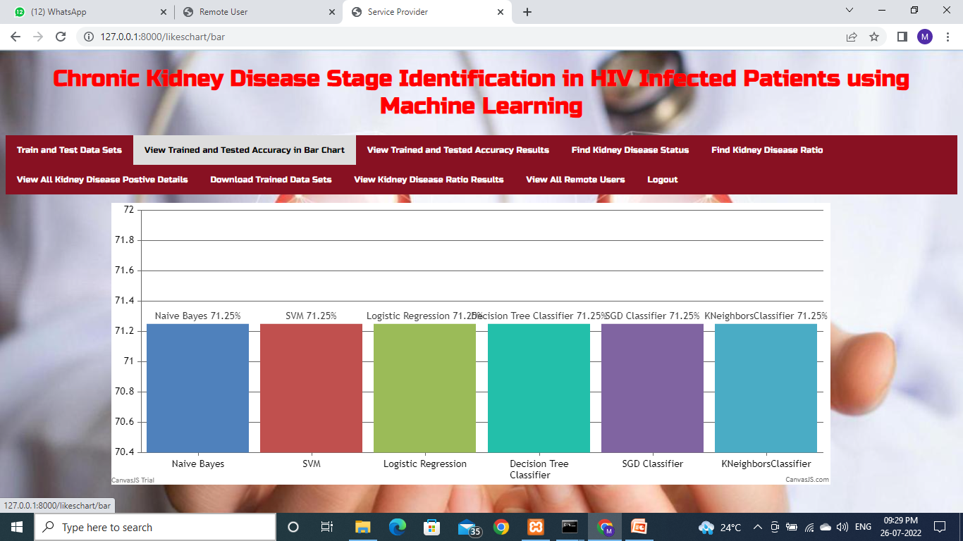
Service Provider

Slide 20

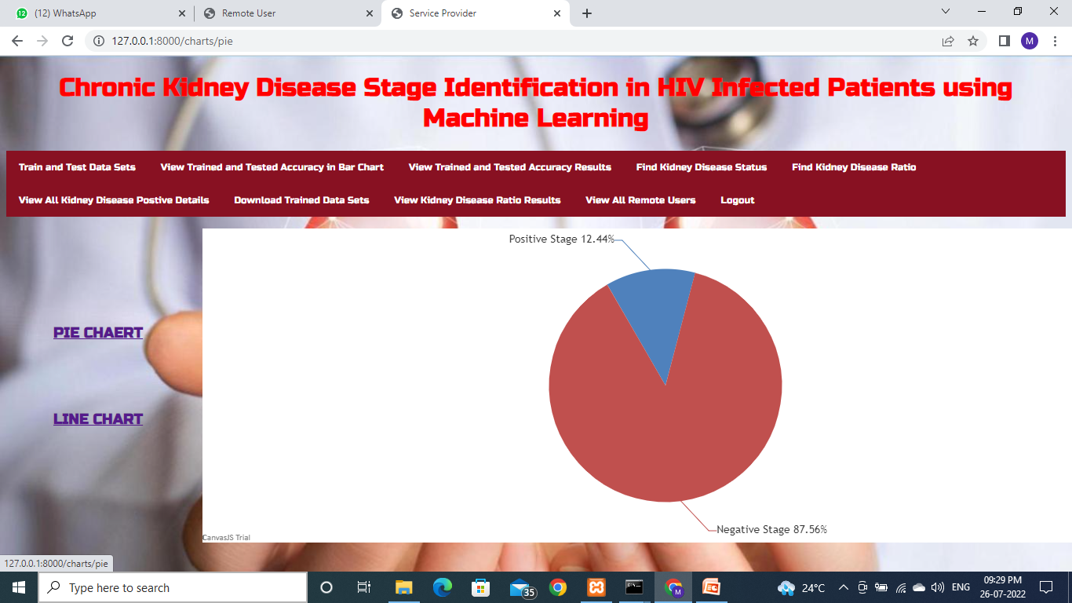
Service Provider

Slide 21
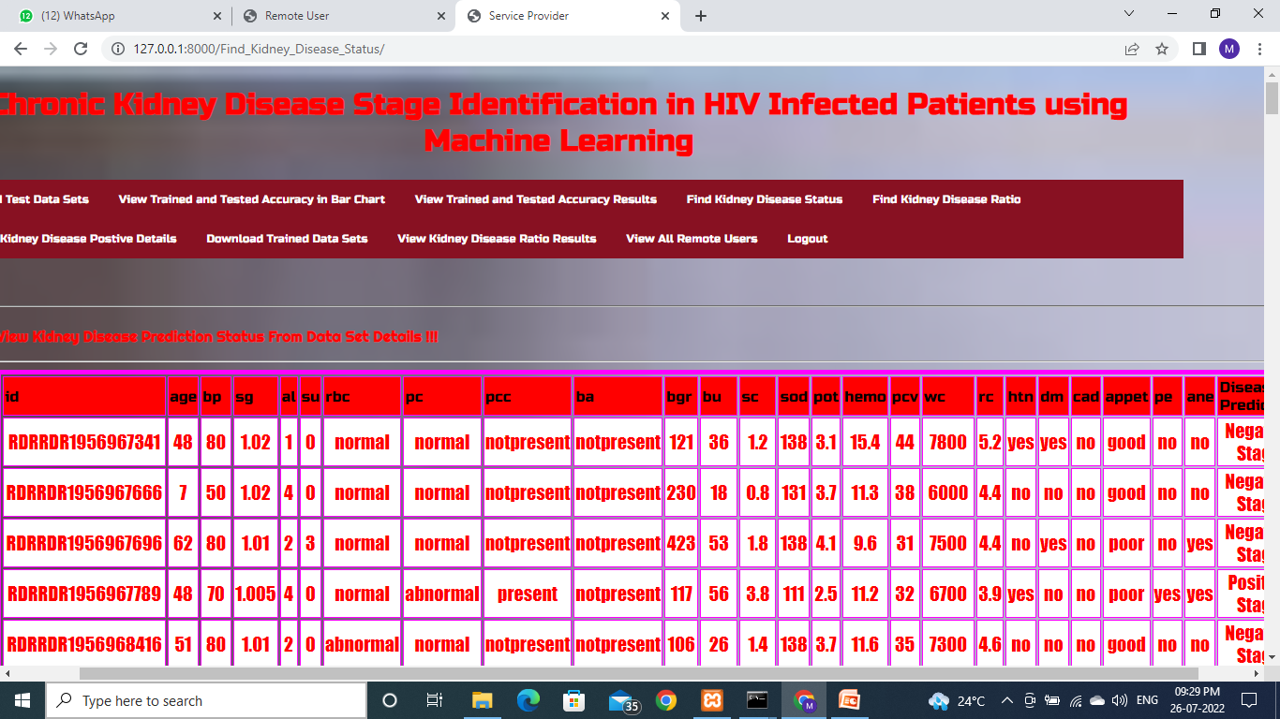

Service provider

Slide 22
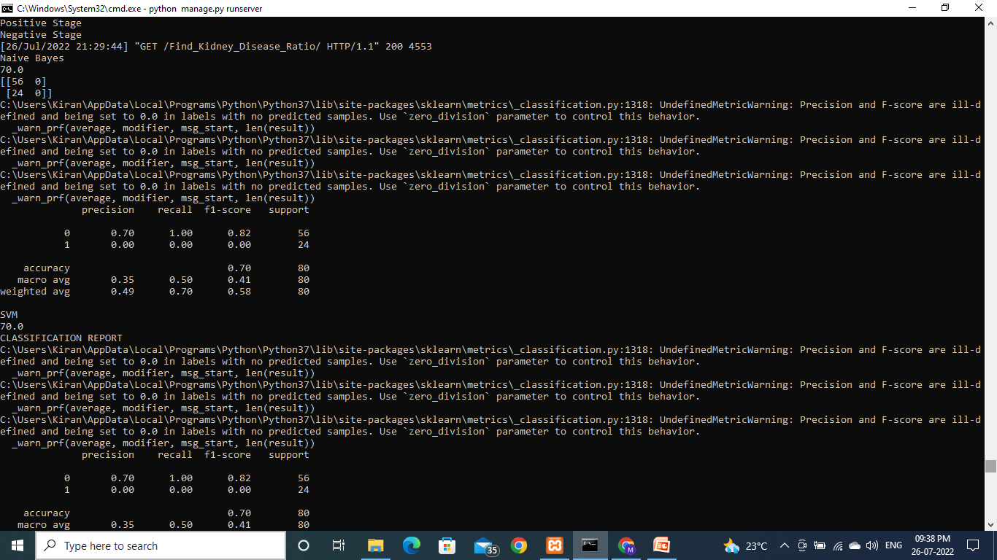
Accuracy

Slide 23
RESULTS AND DISCUSSION
Plan of Implementation
Algorithms | Accuracy
logistic regression | 98%
sgd | 98%
DT | 97%
knn | 97%
DT, Naïve bayes | 96%
svm | 93%

Slide 24
CONCLUSION
This system presented the best prediction algorithm to predict CKD at an early stage. The dataset shows input parameters collected from the CKD patients and the models are trained and validated for the given input parameters. K-Nearest-Neighbors Classifier, Decision Tree Classifier, Naïve Bayes, Logical Regression and SVM, SGD models are constructed to carry out the diagnosis of CKD. The performance of the models is evaluated based on a variety of comparison metrics are being used, namely Accuracy, The results of the research showed that Logical Regression and sgd model has better predicts CKD in comparison to the other models and also help to predict chronic kidney disease in Hiv infected patient.

Slide 25
FUTURE SCOPE
This would help detect the chances of a person having CKD further on in his life which would be really helpful and cost-effective people.
This model could be integrated with normal blood report generation, which could automatically flag out if there is a person at risk.
Patients would not have to go to a doctor unless they are flagged by the algorithms.
This would make it cheaper and easier for the modern busy person.
Ckd ranges from mild to severe all 5 stages of ckd can be predicted

Slide 26
REFERENCES
M.P.N.M. Wickramasinghe, D.M. Perera and K.A.D.C.P. Kahandawaarachchi, "Dietary prediction for patients with Chronic Kidney Disease (CKD) by considering blood potassium level using machine learning algorithms," 2017 IEEE Life Sciences Conference (LSC), Sydney, NSW, 2017, pp. 300-303
U.N. Dulhare and M. Ayesha, "Extraction of action rules for chronic kidney disease using Naïve bayes classifier," 2016 IEEE International Conference on Computational Intelligence and Computing Research (ICCIC), Chennai, 2016, pp.1-5.
R. Devika, S.V. Avilala and V. Subramaniyaswamy, "Comparative Study of Classifier for Chronic Kidney Disease prediction using Naïve Bayes, KNN and Random Forest," 2019 3rd International Conference on Computing Methodologies and Communication (ICCMC), Erode, India, 2019, pp. 679-684.
G. Kaur and A. Sharma, "Predict chronic kidney disease using data mining algorithms in hadoop," 2017 International Conference on Inventive Computing and Informatics (ICICI), Coimbatore, 2017, pp. 973-979.

Slide 27


